Slide 1
UNIVERSITY OF WISCONSIN–MADISON
Teaching and Learning Technology Advising Group

Slide 2
WELCOME & INTRODUCTIONS

Slide 3
UNIZIN SPONSOR TEAMS: CHARGE & DESCRIPTION
TLTAG PRIORITIES
Strategic Directions (everyone)
  Blue Sky / forward
Data Policy (9)
  Learning Record Store
  Need to Expand Out
  Storage & Curation & Access/Approvals
  Student Success Pt.
Canvas Transition (6)
  Issues in Exporting
T&L Fees (5)
Course Packets with Copyright Materials (4)
E-Proctoring & E-exams (4)
OER (4)
Intro to Unizin Tools/Influence of Unizin Directions (3)
Plagiarism Detection (2)
Non Credit Infrastructure (2)
Online Course Evals
Authorizing & Quizzing
Three Themes
Structure / Process
Policy
Tools

Slide 4
UNIZIN SPONSOR TEAMS:
CHARGE & DIRECTION

Slide 5
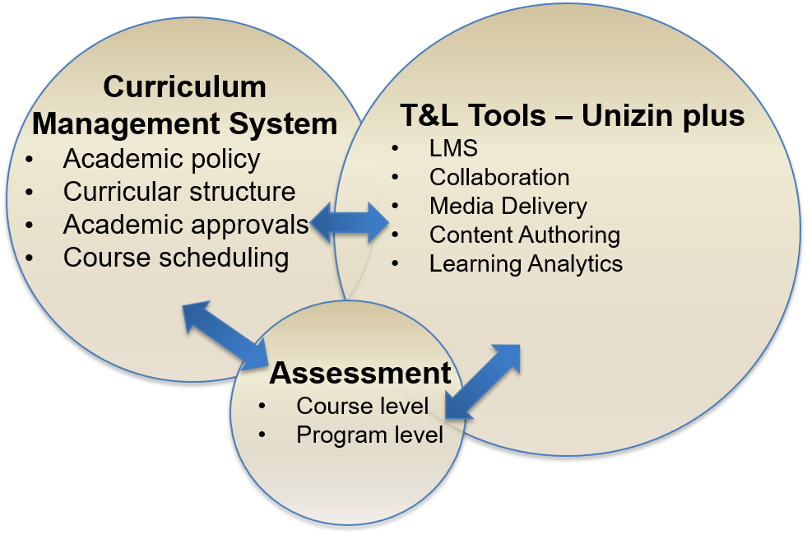
UNIZIN SPONSOR TEAMS: CHARGE & DESCRIPTION
STUDENT DIGITAL ECOSYSTEM:
TEACHING & LEARNING TOOL ADOPTION PROCESS
T&L Tool Adoption Process
How do we:
- Identify –
- Analyze -
- Prioritize -
- Decide -
- Maintain -
Input from
Campus
(EI, ITG, TLTAG,
ITC, etc.)
Input & Tools from
UW System
(Kaltura, BlackBoard Ultra, etc.)
Tools from
Unizin
(Snapshot, Unizin Data Warehouse, Pressbooks, etc.)
Learn@UW-Madison Executive Team

Slide 6
UNIZIN SPONSOR TEAMS: CHARGE & DESCRIPTION
CONSORTIUM PARTNERSHIP ACTIVITIES
Joint Projects
Community of Practices (COP)
Monthly Unizin Webinars
Unizin Sponsor Teams
Consortium Product Groups
  Analytics Group for Unizin Data Warehouse & Course Monitor
  Content Group for Engage, Pressbooks & Content Studio
Unizin Teaching & Learning Group
Unizin Summit

Slide 7
UNIZIN SPONSOR TEAMS: CHARGE & DESCRIPTION
UNIZIN TOOLS
Canvas
Course Monitor
Unizin Data Warehouse
Pressbooks
Content Studio
Engage

Slide 8
UNIZIN SPONSOR TEAMS: CHARGE & DESCRIPTION
EXPLORING & ADOPTING UNIZIN TOOLS
Stages of tool development | Discover | Design | Develop | Launch | Adopt
Campus team structure to explore and adopt
Canvas
Course Monitor
Unizin Data Warehouse
Pressbooks
Content Studio
Engage
UW-Madison
IT Teams
Tool is now part of operations and managed by DoIT AT services*
Unizin Sponsor Teams
1-3 people engage with Unizin and UW-Madison campus
UW-Madison has a full team assigned or has adopted
UW-Madison has a partial team assigned
UW-Madison is not represented on sponsor team
The point where Unizin expects schools to test and pilot tools
Notes:
* DoIT Academic Technology services that will support and manage the tool once it’s in operations, includes Learn@UW-Madison, Learner Digital Ecosystem and others as needed

Slide 9
CANVAS TRANSITION UPDATE

Slide 10
CANVAS TRANSITION UPDATE
CURRENT SUB-PROJECTS
Support
Functional Gaps
Technical
Communications
LMS Service Retirement
Learn@UW Operations
Notes:
Support: SCIDD by SCIDD migration approach and support strategy. 6 SCIDDs migrating Spring 2017.
Functional Gaps: Quizzing and content authoring research, Maple TA pilot, Canvas quiz engine 2.0 investigation, content authoring tools LTI compatibility
Technical: Snapshot implementation, Learn@UW web redesign, grade export automation to Faculty Center
Communications: CSCR communication, Snapshot, Canvas Commons, Func Gaps communications plans
LMS Service Retirement: Exploring policy and technical issues
Learn@UW Operations: Help Desk recommendation, feature request work group, and Canvas course retention policy

Slide 11
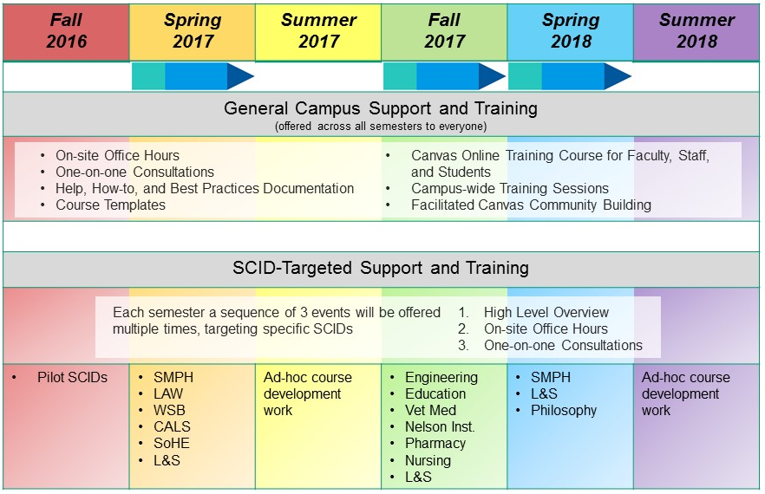
SCIDD SUPPORT TIMELINE
FOR CANVAS CREDIT TRANSITION

Slide 12
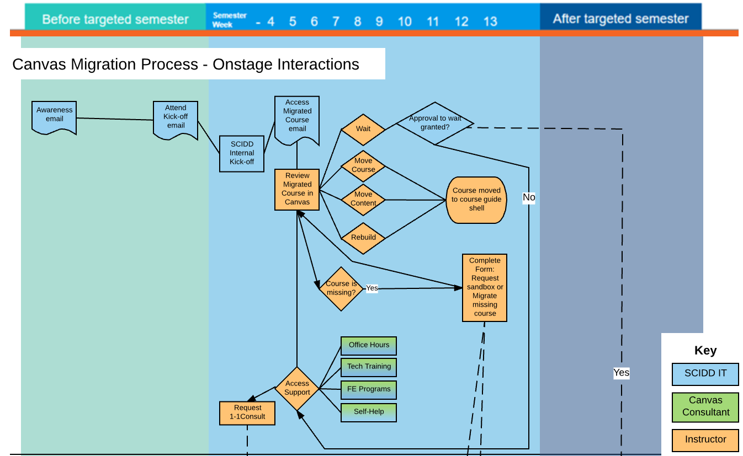
MIGRATION STRATEGY

Slide 13
CANVAS TRANSITION UPDATE
MIGRATION STRATEGY
Faculty Review Migrated Course
Receive e-mail encouraging them to review their course in Canvas
Faculty determine next steps
Wait
Faculty take advantage of assistance
Office hours with their colleagues
Move course
Move content
Re-build course
Online & F2F training
Consultations

Slide 14
CANVAS TRANSITION UPDATE
FUNCTIONAL GAPS:
Recommendations Shared with ITG, 1/19/17
Content Authoring
  Investigate other content authoring tools and LTI communication to Canvas
  Alternatives to CSCR
  (Notification sent 1/24/17)
Quizzing
  Maple TA Pilot
  Research other quizzing tools for non-math use (Canvas Quiz Engine 2.0, other LTI solutions

Slide 15
CANVAS TRANSITION UPDATE
ITG: FEATURE REQUEST PROJECT
Drafted by ITG working group
Executive Team approved 1/9/17
Beginning to meet, drafting charter and completing initial prioritization
Team members = Kristy Bergeron, Cliff Cunningham, Steel Wagstaff, Erica Hagen, Billy Kardasz

Slide 16
FEEDBACK / QUESTIONS

