Slide 1


Introduction to Shiny

Slide 2


Introduce the speaker
Ryan Johnson
ryan@posit.co
Data Science Advisor
@ryjohnson09
Questions? Pop them in the chat (Zoom / MS Teams).
Keep it fun, keep it casual, keep it safe!
Slides, material, and recording will be made available after.

Slide 3
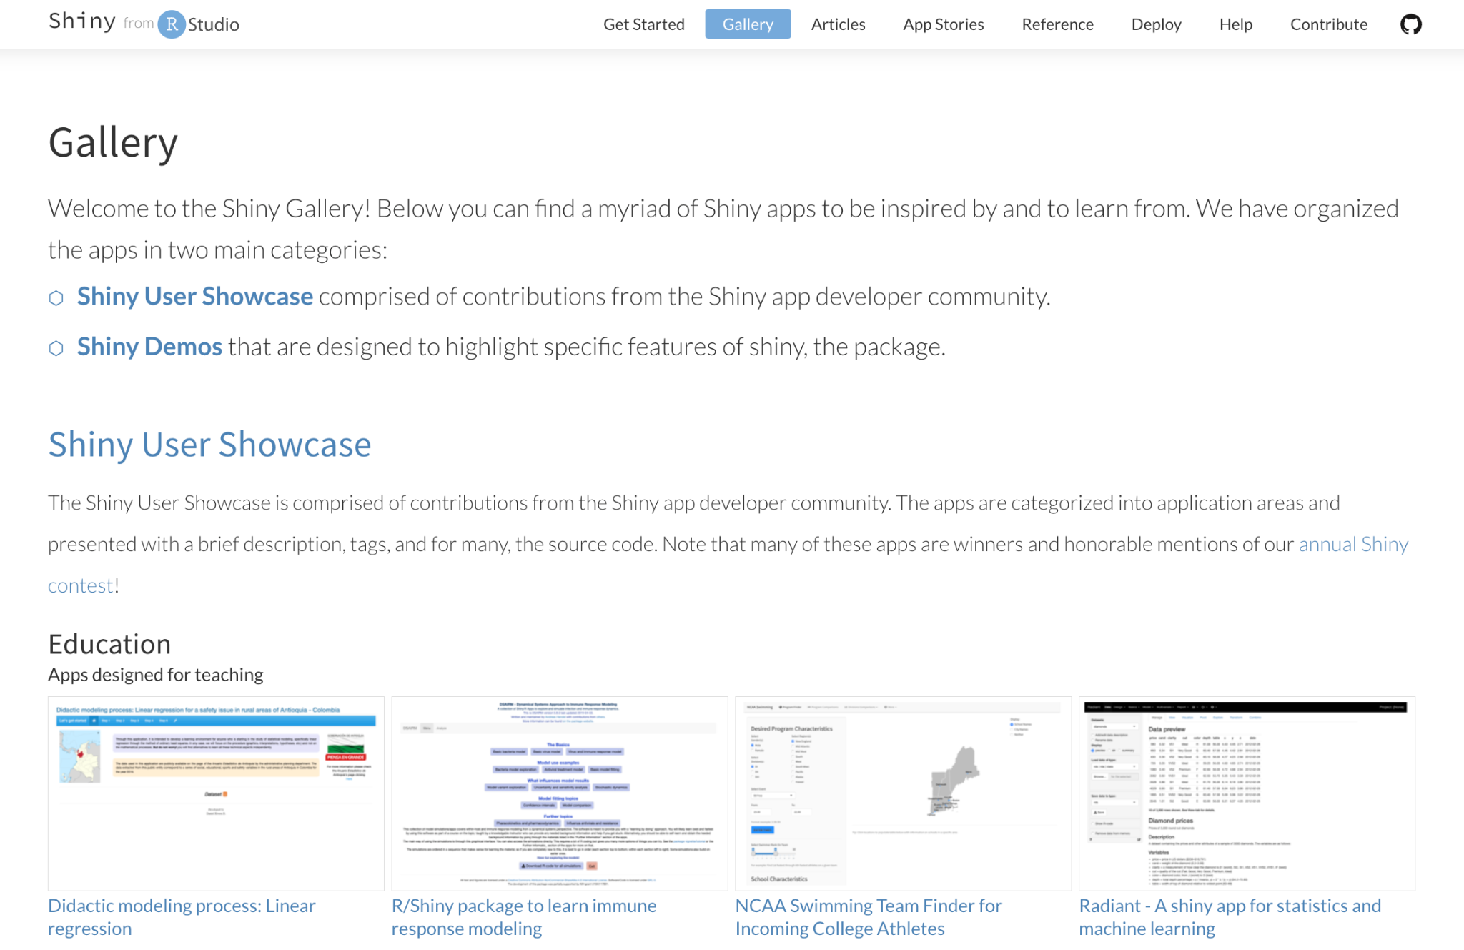
What is Shiny?
Take 1 minute, and see for yourself!

Slide 4
What is Shiny? 2
Open Source R Package
Build Web Apps using R
Code Based
Extremely Customizable
…did I mention it’s free?

Slide 5
Let’s create a Shiny App Together!
Two Options:
Posit Cloud (Intro to Shiny) - RStudio Project with Shiny already installed
Open your own instance of the RStudio IDE (Desktop or Posit Workbench)

Slide 6
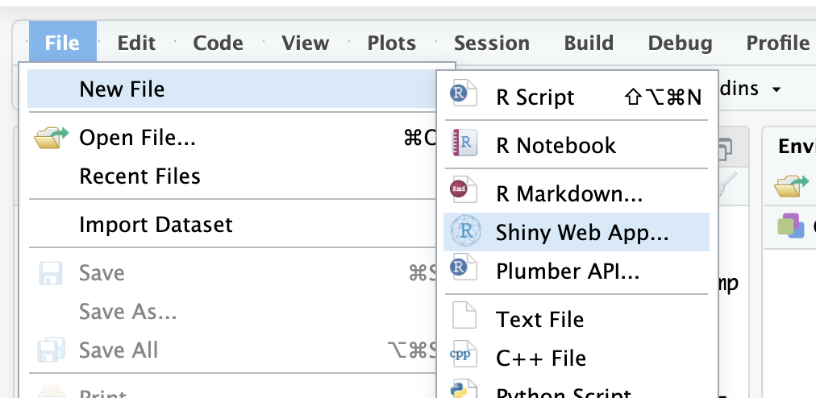
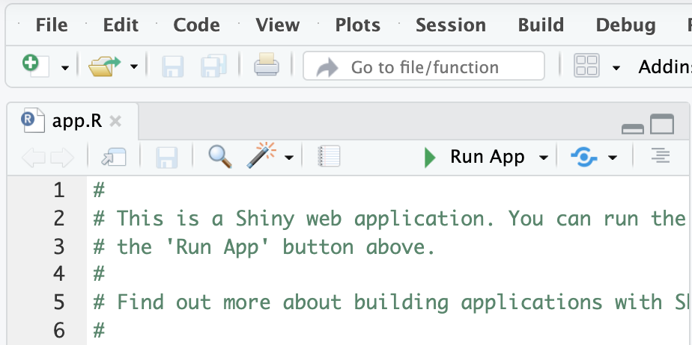
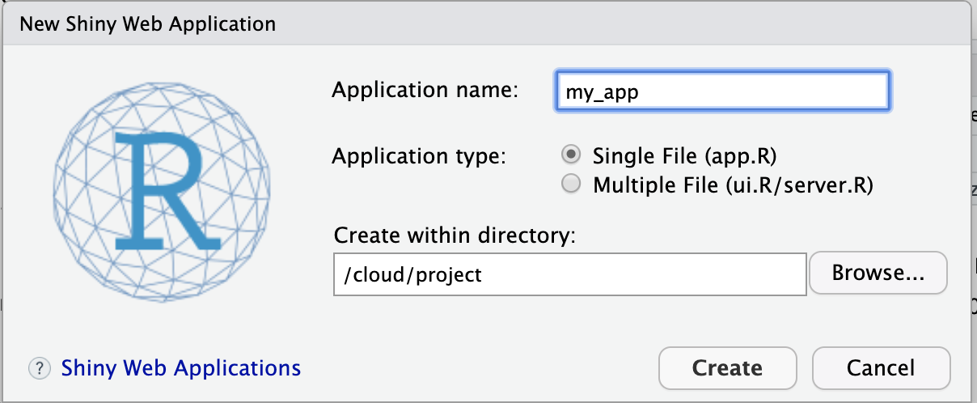
Let’s launch our first app!
1.
3.
2.

Slide 7
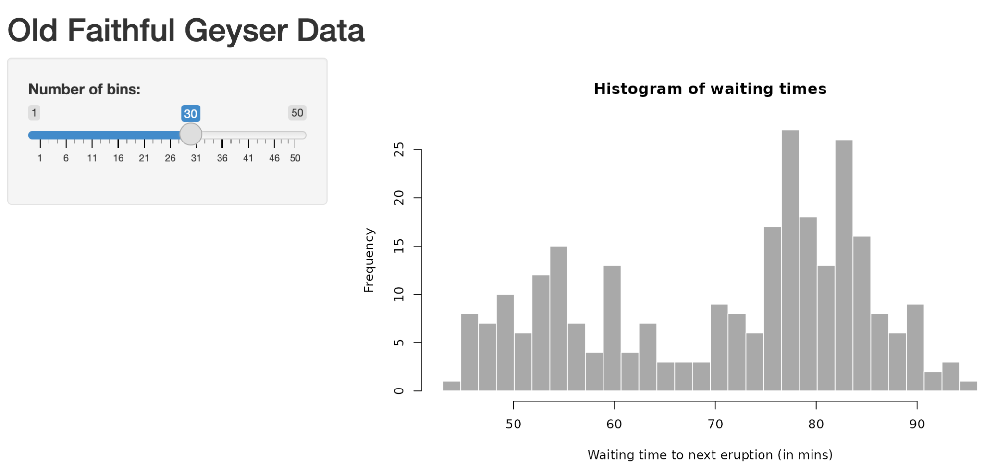
Diagram of a shiny app
Input changes
Running R code
Server
Output changes

Slide 8
Diagram of a shiny app + explanation
Input changes
Running R code
Server
Output changes
Server
UI
What do I see / touch?
What does the app DO?

Slide 9
Diagram of a shiny app + components
Input changes
Running R code
Server
Output changes
UI
Server
Title
Slider
Graph
Receive the slider input
Create a histogram

Slide 10
What’s in an app?
library(shiny)
ui <- fluidPage()
server <- function(input, output) {}
shinyApp(ui = ui, server = server)

Slide 11
What’s in an app? 2
Header
library(shiny)
ui <- fluidPage()
server <- function(input, output) {}
shinyApp(ui = ui, server = server)
User Interface
Server
Run App!

Slide 12
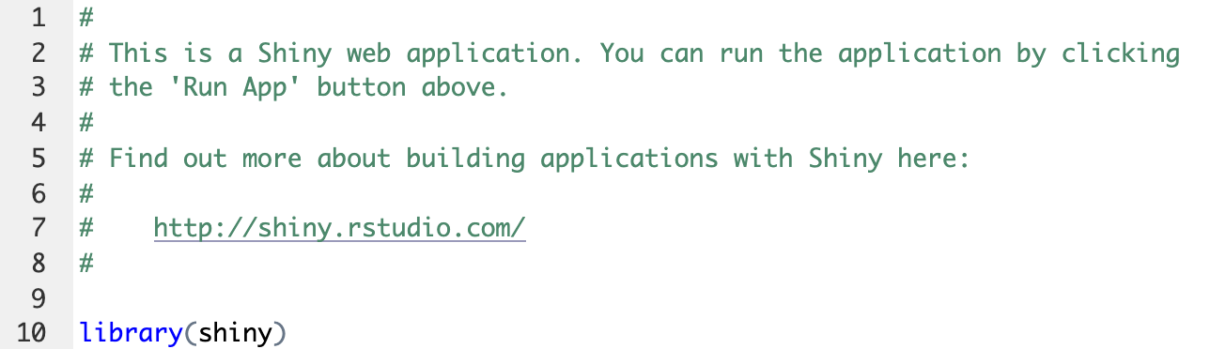
The Header
The first part of your app.R file
Everything in this section will run as soon as someone connects to your app
Put things in here that you always need for every part of your app - loading data and packages, data wrangling/transformation steps, etc.

Slide 13
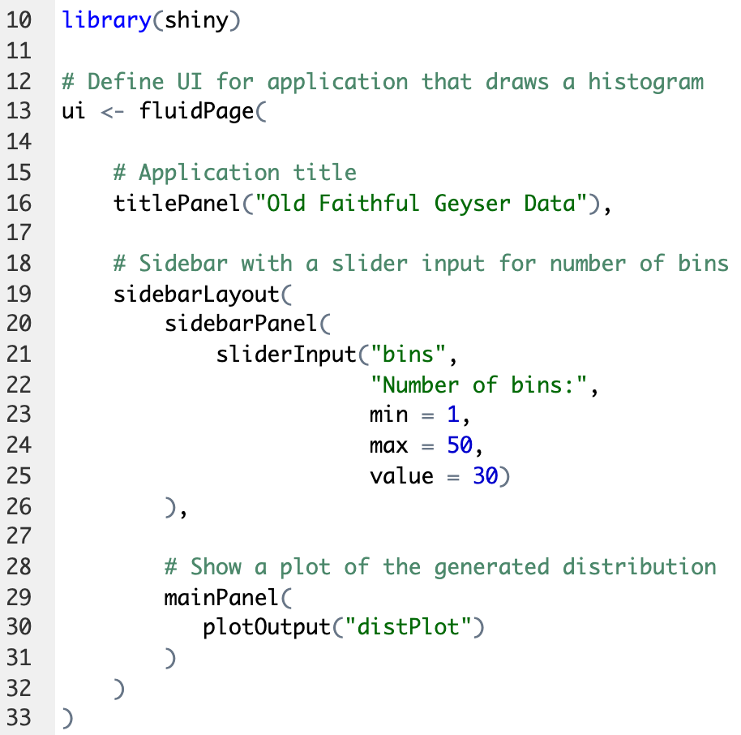
2. The UI (user interface)
The second part of your app.R file
Define the visual layout of your app (where to put inputs and outputs)
Define inputs and how they work
Define outputs and what types they are

Slide 14
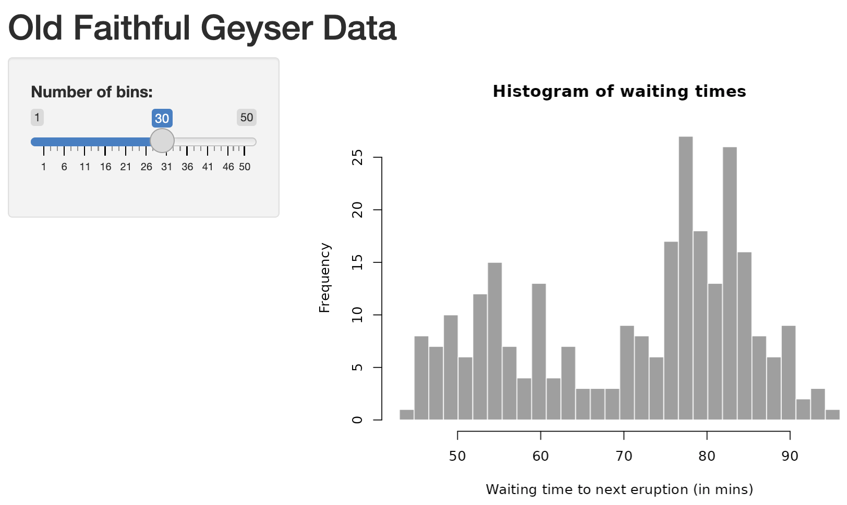
UI

Slide 15
UI 2

Slide 16
UI 3

Slide 17
UI 4

Slide 18
Assignment - Modify the UI
Change the app title to “My Super Cool Geyser Data”
Change the maximum number of bins on the slider to 100.

Slide 19
UI - Layout

Slide 20
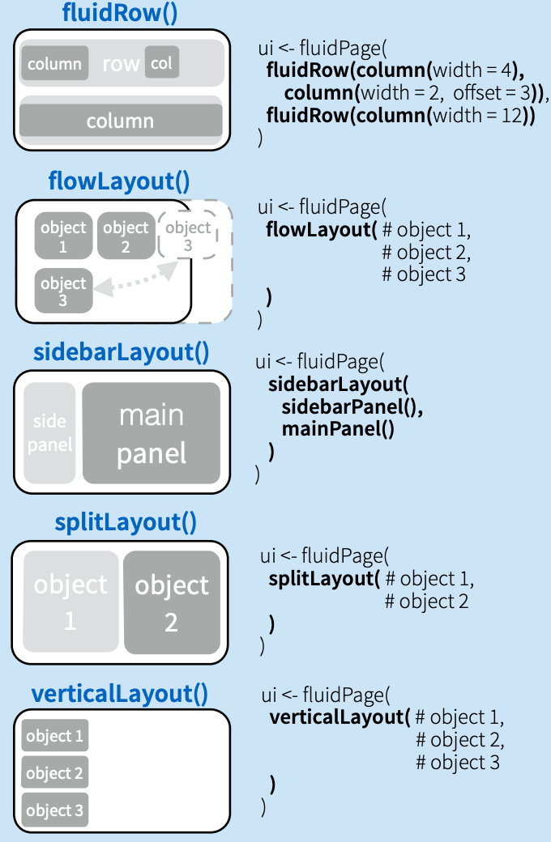
UI
Layout Examples

Slide 21
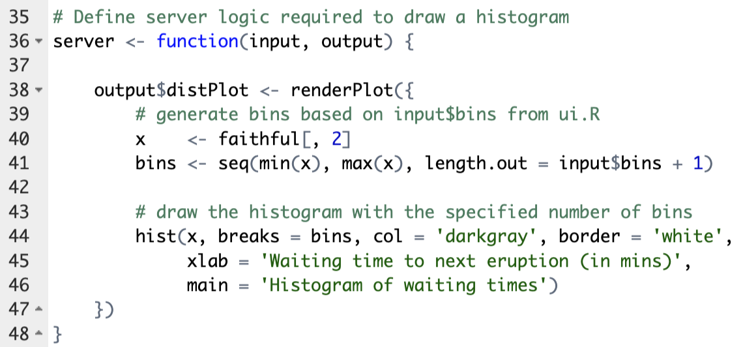
3. The server()
The third part of your app.R file
Most of your R code lives here.
Tells Shiny how to build outputs.
Can use values from user inputs by calling input$id

Slide 22
Assignment - Modify the Server
Change the histogram bin color from `darkgray’ to ‘green’
Change the border color from ‘white’ to ‘black’

Slide 23

4. shinyApp()
The fourth and final part of your app.R file
Tells Shiny to run the app!
Needs to know where to find UI and server parts

Slide 24
Inputs and Outputs
Input changes
Running R code
Server
Output changes

Slide 25
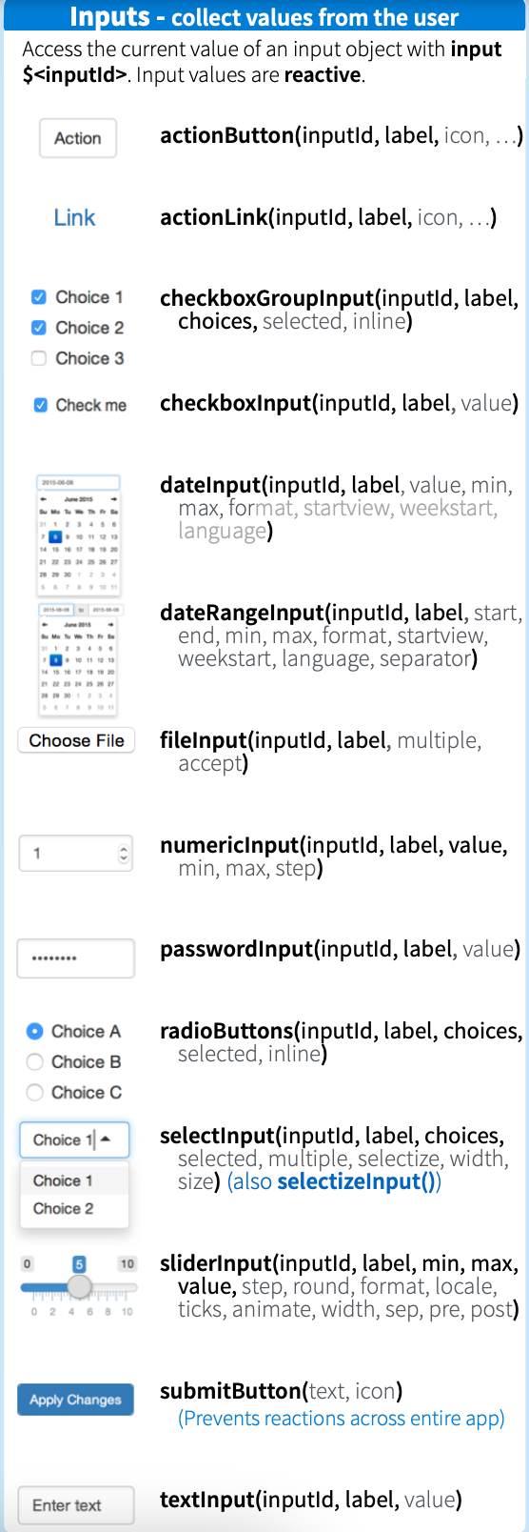
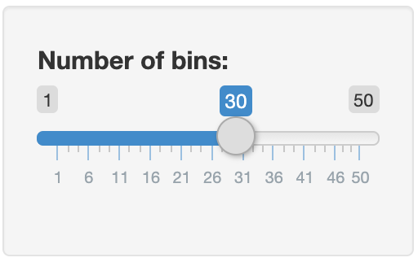
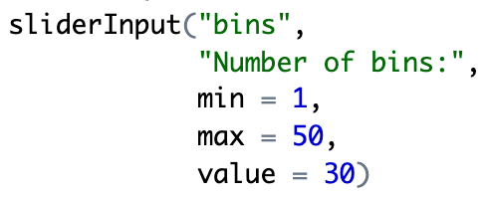
Part of a sliderInput function + output
input_of_choice(inputID, label, …)
= 30

Slide 26
Input component in the GUI, in the server, and in the output
input_of_choice(inputID, label, …)
= 30

Slide 27
How to access the output of a plot
output$distPlot

Slide 28
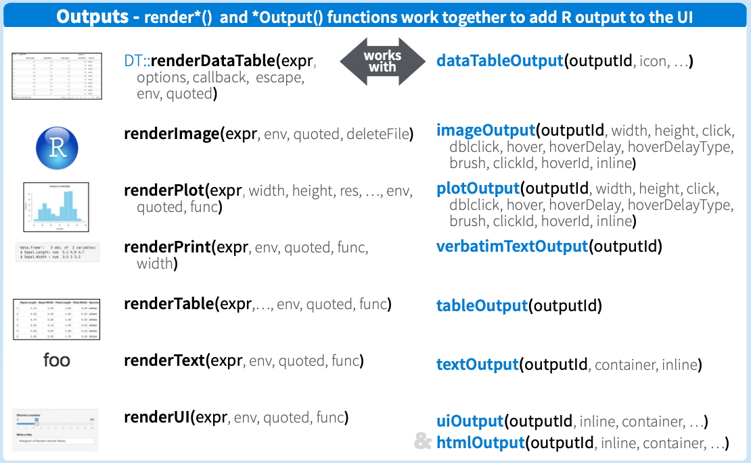
Various types of render functions
output$distPlot

Slide 29
A plot in the UI, the server and the output
output$distPlot

Slide 30
A plot in the UI, the server and the output 2
output$distPlot

Slide 31
3 Rules for the Server Function
Save objects you want to display as output$
Build object with a render*()
Access input values with input$
output$distPlot<-renderPlot({...})
output$distPlot<-renderPlot({...
bins <- seq(min(x), max(x), length.out = input$bins + 1)
....})

Slide 32
A diagram of reactivity
Input changes
Running R code
Server
Output changes
UI
Server
input$bins
sliderInput(“bins”, …)
output$distPlot<-renderPlot({...
})
plotOutput("distPlot")
output$distPlot

Slide 33
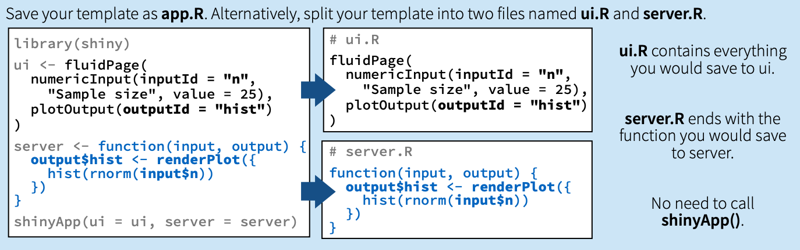
Saving your shiny app

Slide 34
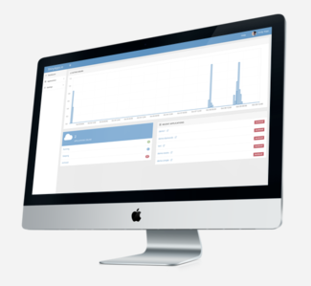


Sharing your shiny app
Hosted Solutions
On-Prem Solutions
shinyapps.io
Shiny Server

Slide 35
Let’s deploy our Shiny App to:

Slide 36
Recap what you learned
Basic Structure of a Shiny App
Customizing the shiny UI
Shiny Server Rules
Input and Outputs
Saving & Publishing Your App

Slide 37
Keep Learning about Shiny!
Shiny Gallery
Shiny tutorials
Shiny Cheatsheet
Mastering Shiny

